Slide 1
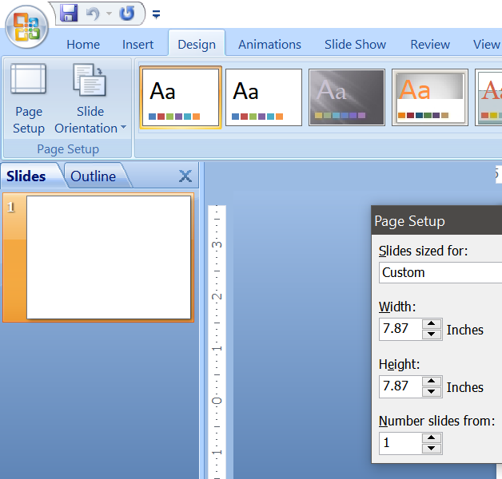
Notes:
Most social media elements are 1080 by 1080px or 7.87” square. Change the page size to meet this and you can use it online or in print and on the website. To change the page size, choose DESIGN and PAGE SETUP from the menu.

Slide 2

Notes:
Start with a Toastmasters stock image or a photo of your own

Slide 3
A
A
Notes:
Add colors to ground it, give it structure and provide a place for your message. This is the Toastmasters color Loyal Blue. Yes, you can use gradients all the way to 70% transparency. (See the Toastmasters Brand Manual)

Slide 4

A
A
Notes:
Place the logo giving ample clear space all around.

Slide 5
Xxxxx Toastmasters
https://xxxxxxx.toastmastersclubs.org/
Xxxxx 1, 2020, 6PM
Venue: xxxxxxxx
RSVP: 111.222.3333
Notes:
Add your club name and message. Be sure to include your club’s website URL and/or a phone for RSVPs/questions. This is the Arial font but any approved Toastmasters brand font is good. (See the Toastmasters Brand Manual)
This is looking good but maybe we can do better…

Slide 6
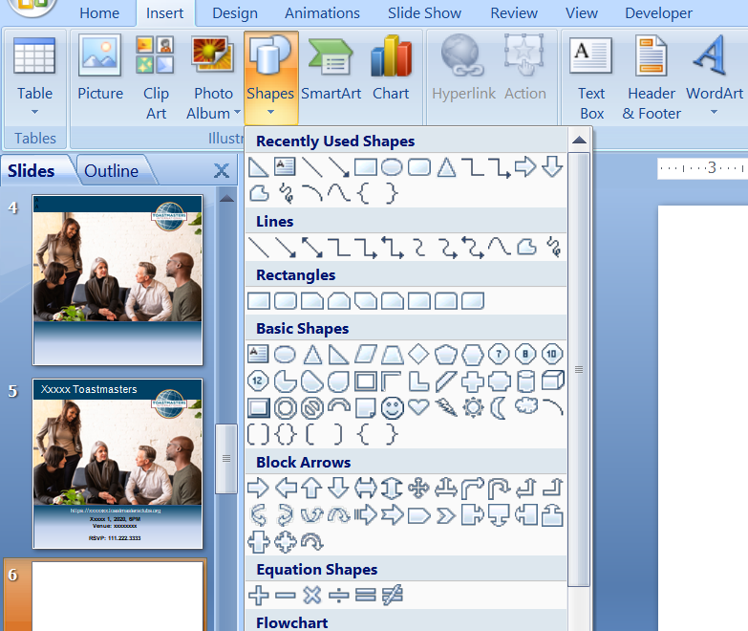
Notes:
Want to get creative? Insert a basic shape. I like using the triangle shapes. Place one on your document and color it.

Slide 7
Xxxxx Toastmasters
https://xxxxxxx.toastmastersclubs.org/
Xxxxx 1, 2020, 6PM
Venue: xxxxxxxx
RSVP: 111.222.3333
Notes:
Using the triangle shape gave it a unique and interesting appearance.

Slide 8
JOIN US!
Xxxxx 1, 2020, 6PM
Venue: xxxxxxxx
RSVP: 111.222.3333
https://xxxxxxx.toastmastersclubs.org/
Xxxxx Toastmasters
Notes:
This is another use of the triangle. You get the idea! Have fun with it – within the Branding standards.

